Slide 1
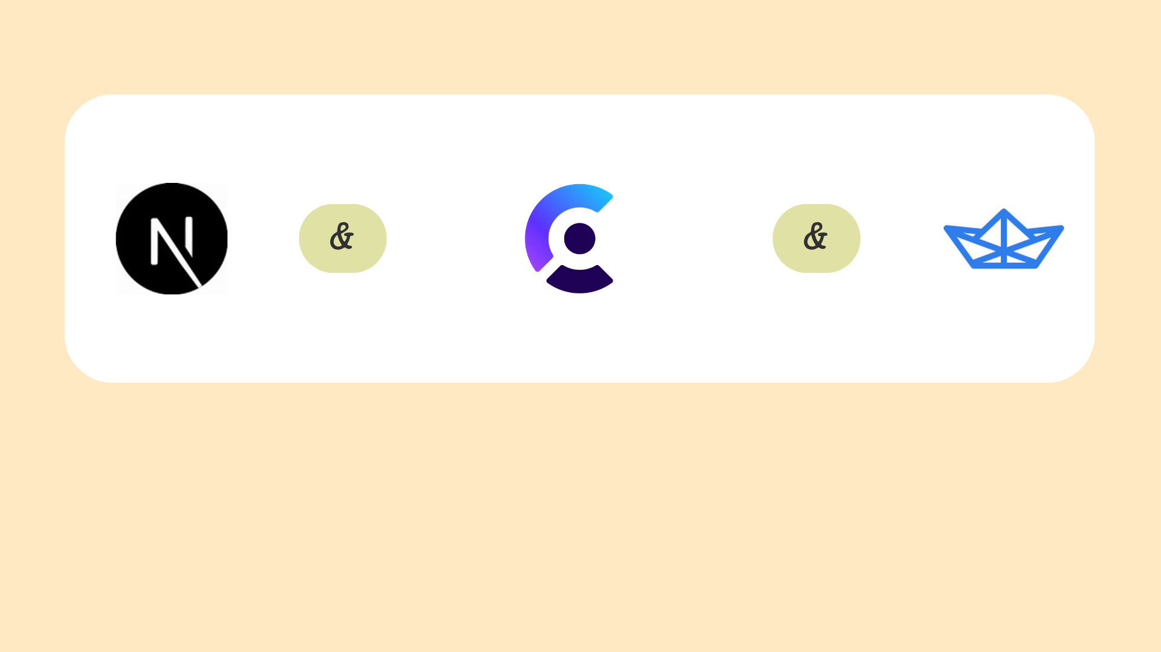
Technologies Used

Slide 2
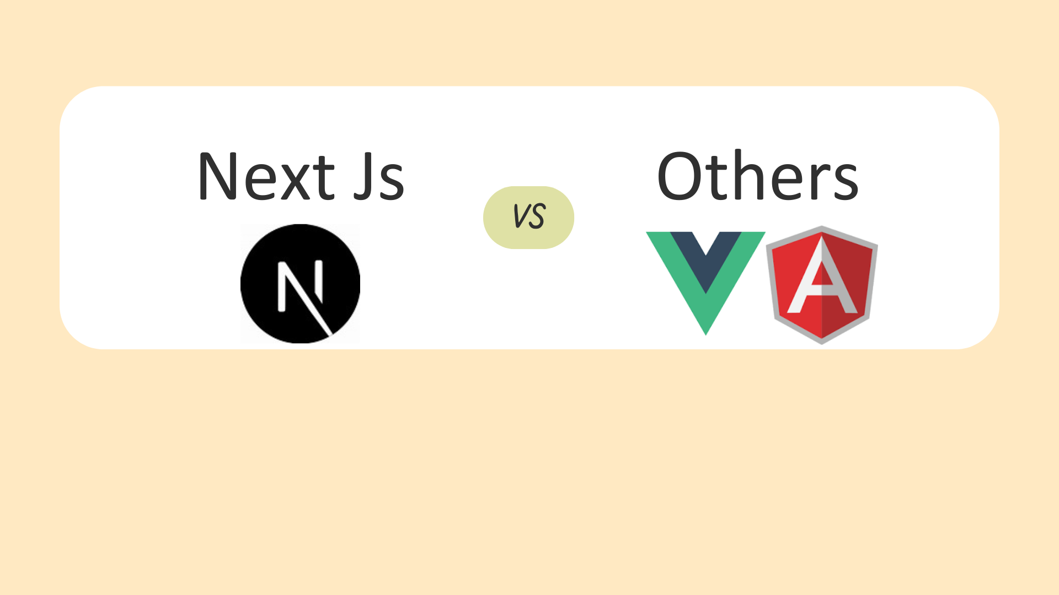
Why Choose Next Js?

Slide 3
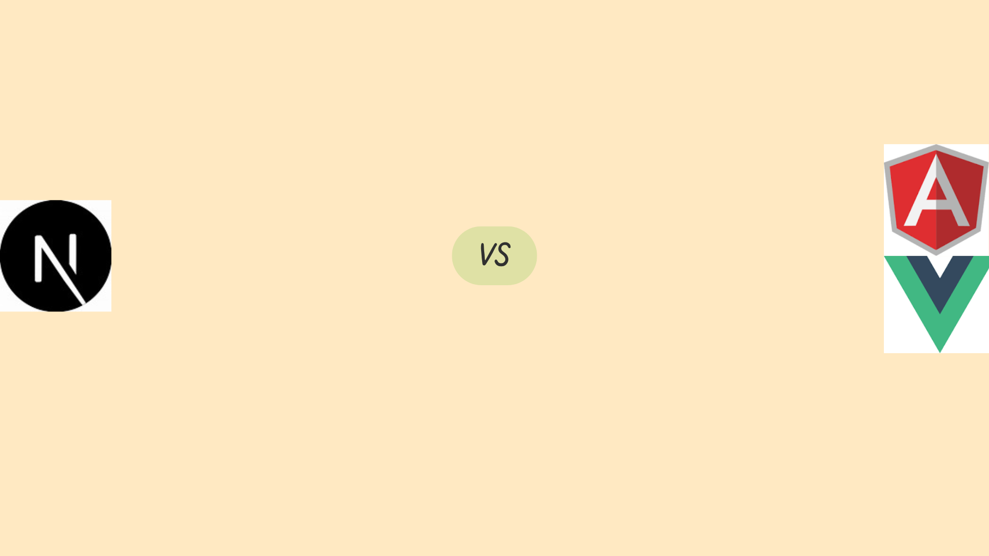
Compare to Angular Js
Simpler Learning Curve: Next.js is easier to learn than Angular.js.
Faster Development: Next.js provides faster development and deployment.
Better Performance: Next.js's SSR and SSG improve performance.4.
Easier Integration: Next.js integrates well with other libraries and frameworks.

Slide 4
Compare to Vue Js
Easier Server-Side Rendering: Next.js provides built-in SSR, while Vue.js requires additional setup.
Faster Development: Next.js provides faster development and deployment.
Better Performance Optimization: Next.js includes automatic code splitting and caching.
Simplified Routing: Next.js has a simpler routing system.

Slide 5
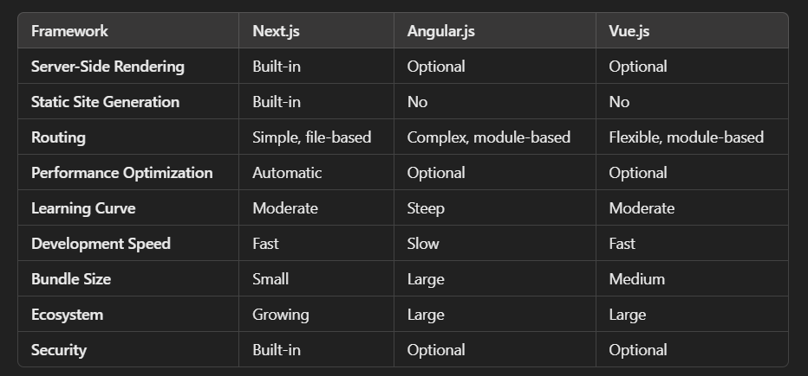

Slide 6
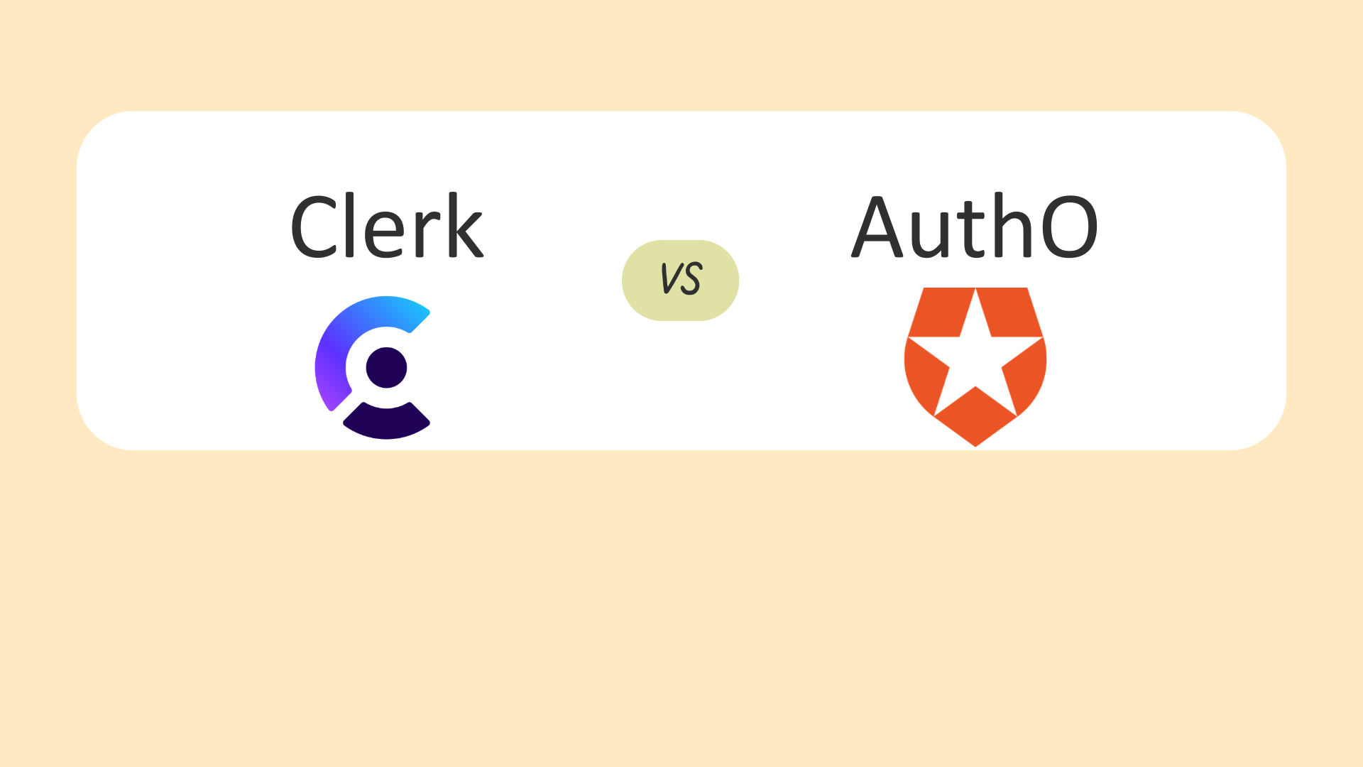
Why Choose Clerk(authentication)?

Slide 7
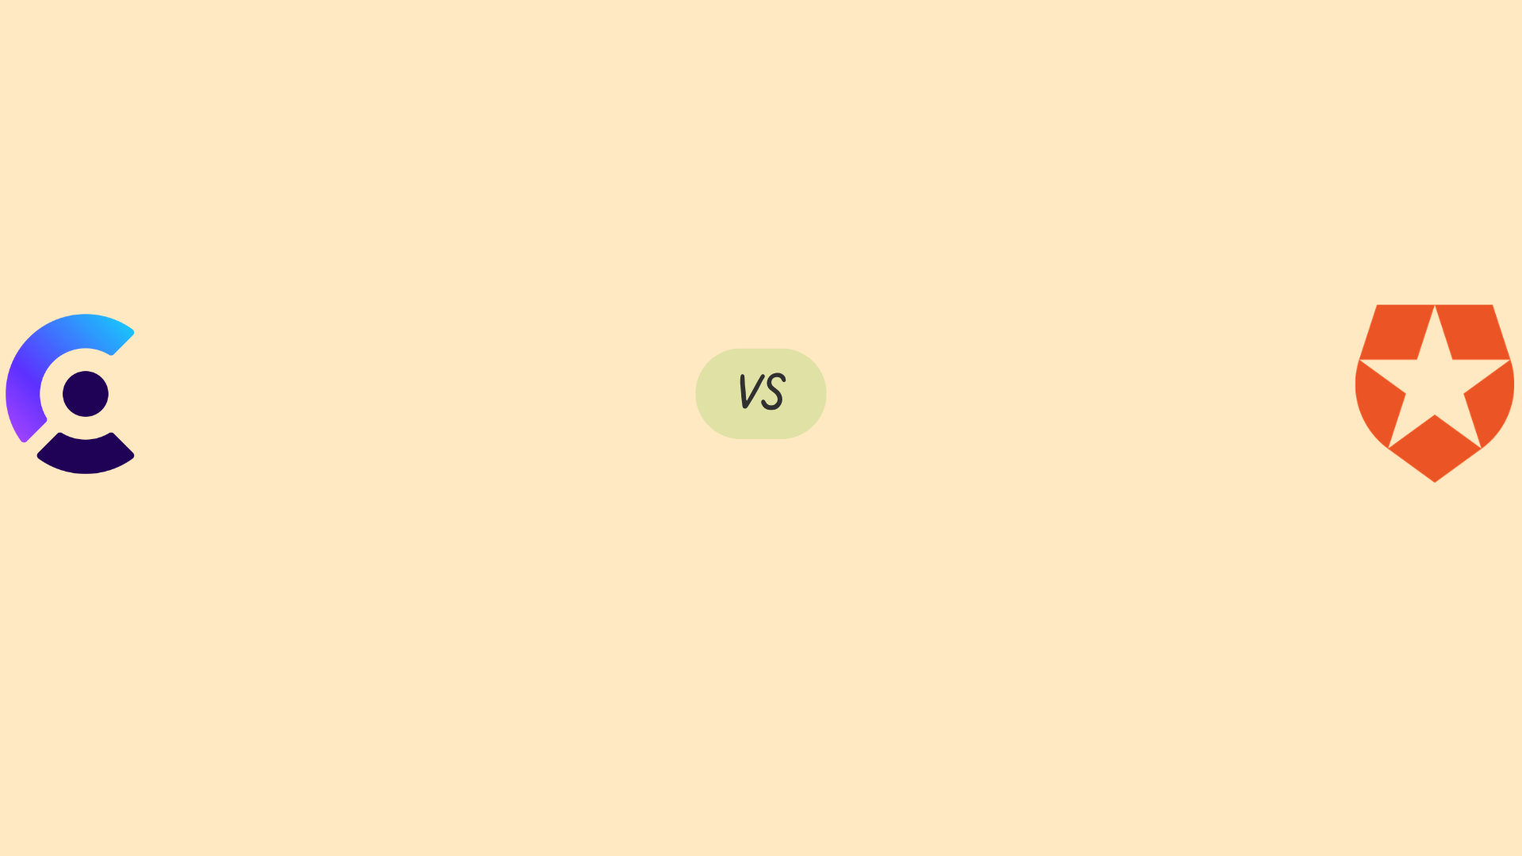
What Clerk provides what Auth0 doesn’t
Prioritize simplicity and ease of use.
Need cost-effective solutions for small to medium-sized applications.
Require advanced security features and compliance support.
Want customizable UI components and authentication methods.
Prefer fast development and deployment.

Slide 8
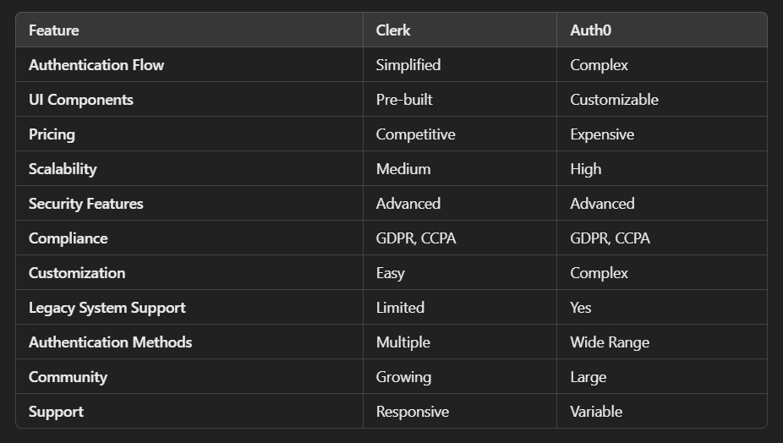

Slide 9
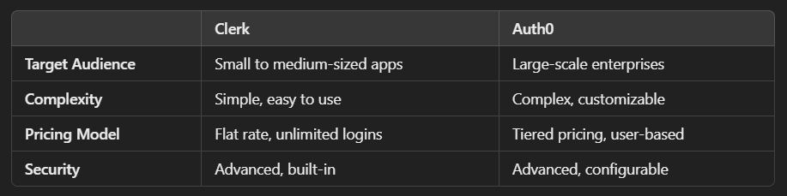

Slide 10
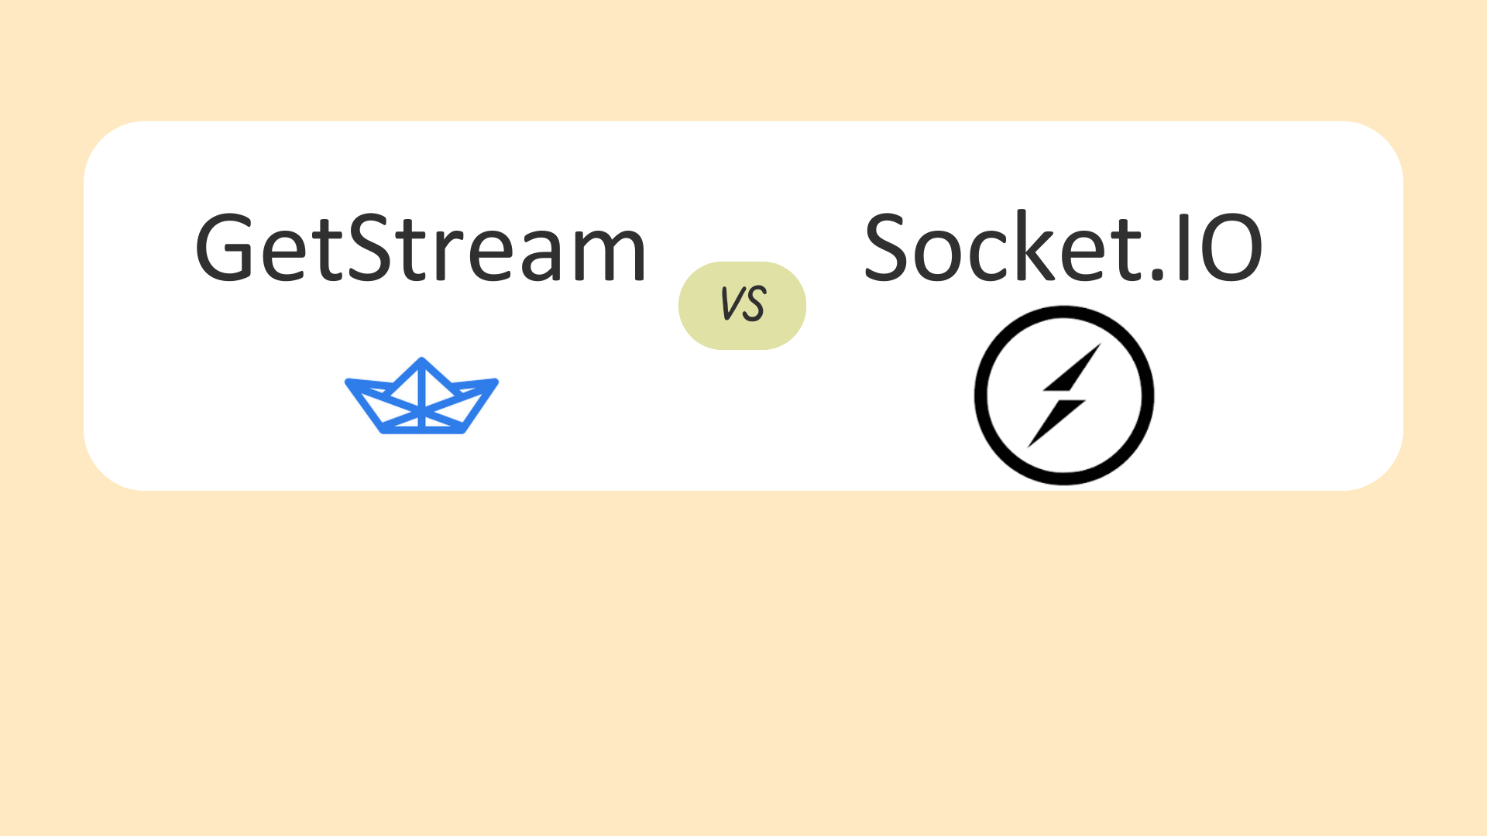
Why Choose GetStream?

Slide 11
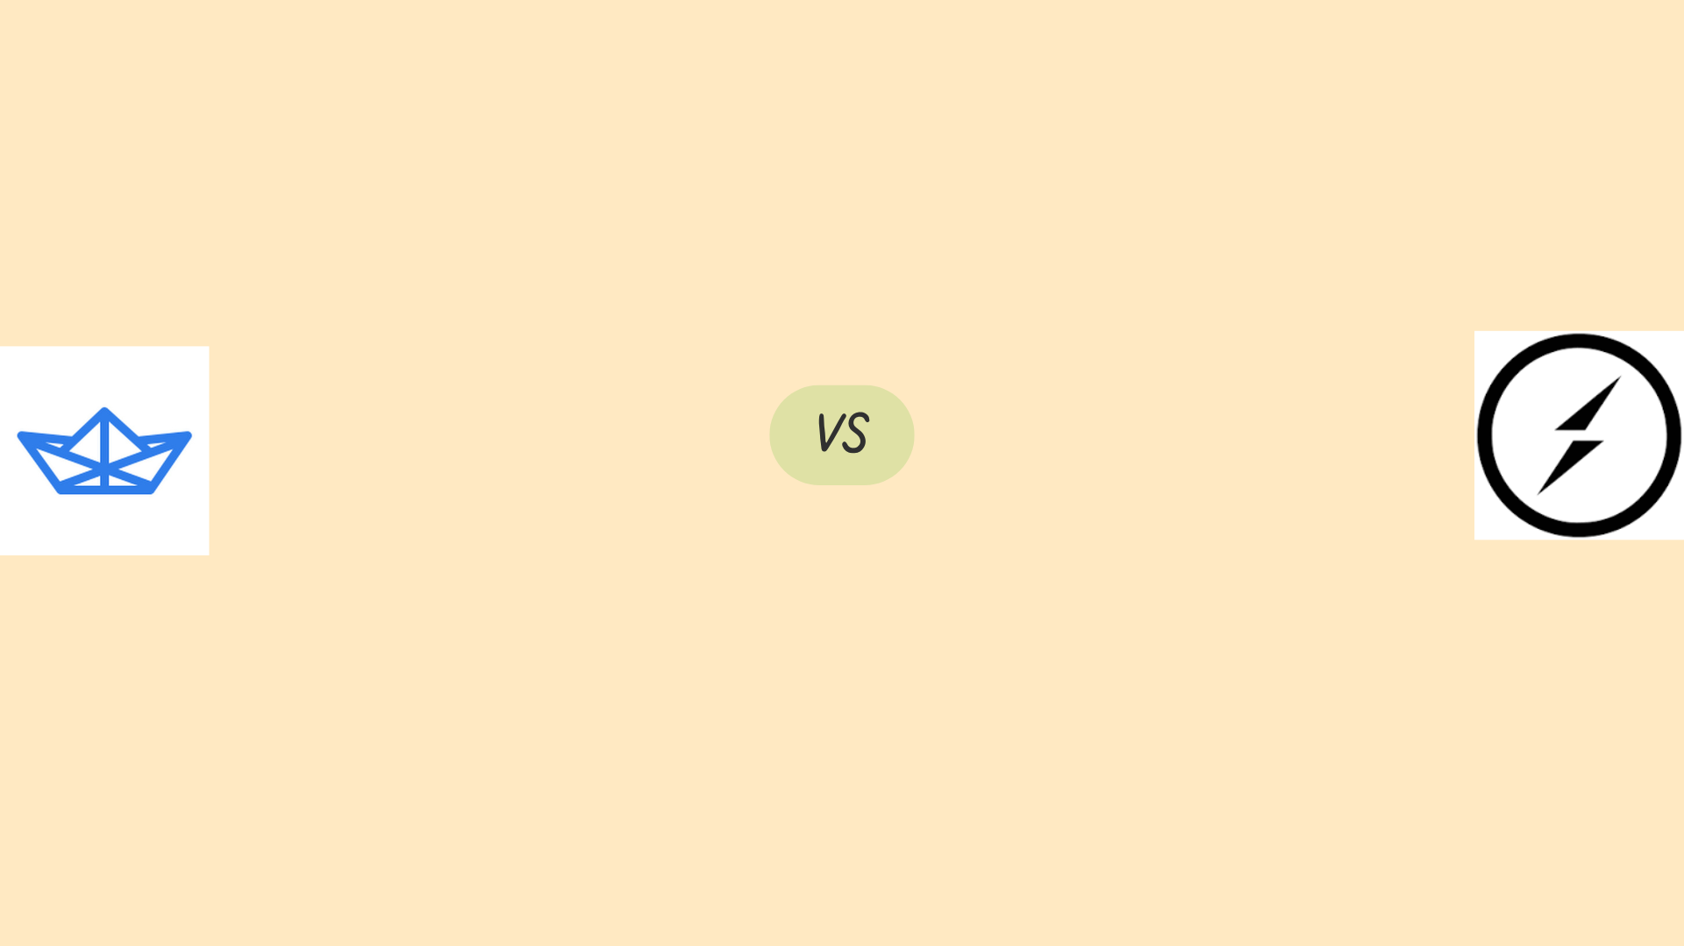
Why GetStream over SocketIO
You want a quick-to-deploy chat or activity feed solution.
You need pre-built components like read receipts, file sharing, and message threading.
You are looking for a fully managed, scalable service.
You want built-in security and compliance (GDPR, CCPA).
You need analytics and insights into chat and user behavior.

Slide 12
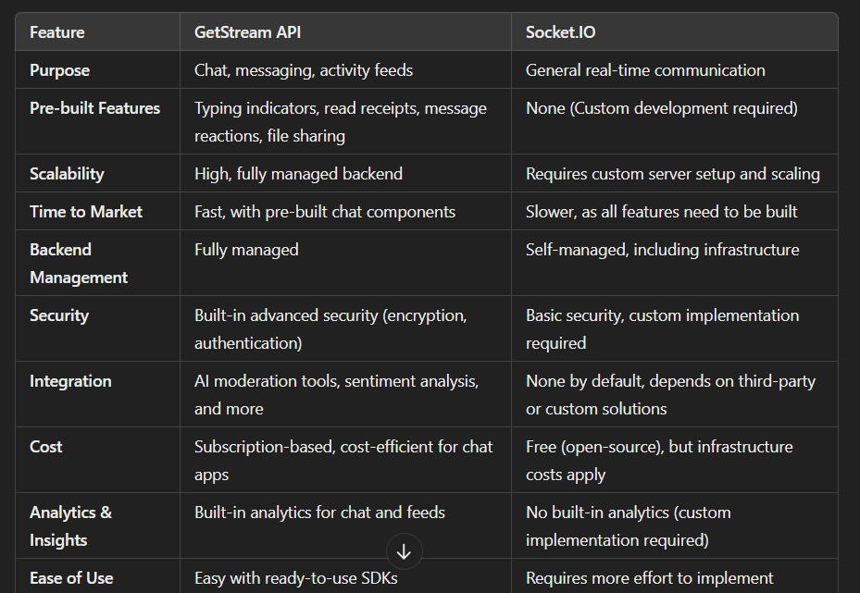

Slide 13
Get Stream can Handle Multiple Users
GetStream can handle multiple users concurrently.
Distributed Scalable Architecture.
Real-Time WebSockets.
API Rate Limiting and Throttling.
Global Data Centers and CDN Integration.
Load Balancing.
Strong Backend Infrastructure and Microservices Architecture

Slide 14
Get Stream can Handle Multiple Users
GetStream is designed to support tens of thousands of concurrent connections per channel
Can scale to handle millions of users across multiple channels.
GetStream offers enterprise-level solutions, which include additional scaling options, dedicated infrastructure, and technical support

